Slide 1
Architecture of a Database Management System (DBMS)
Components and Functions.
NAME: A.SANTHOSH
ROLL NO: 24671A6701
BRANCH: CSE(DS)

Slide 2
Introduction to DBMS.
A DBMS is software that manages data, databases, and users.
  Provides a systematic and organized way of storing, retrieving, and managing data.
  Ensures security, consistency, integrity, and performance.
  Follows a layered architecture to simplify data management.

Slide 3
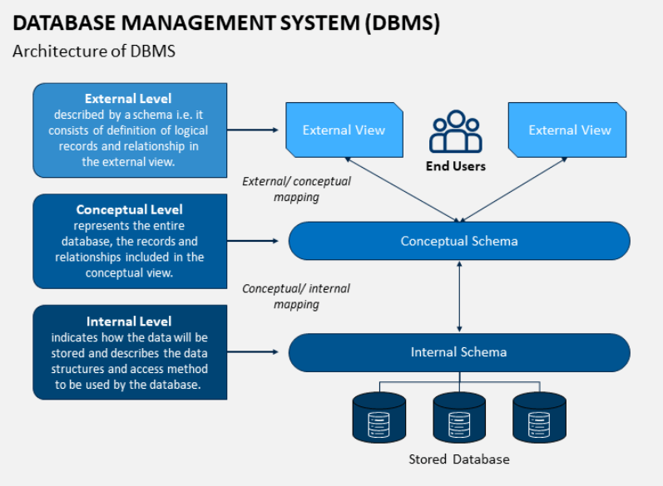
DBMS Architecture Overview
Three main levels of DBMS architecture:
  1. External Level (View Level)
  2. Conceptual Level (Logical Level)
  3. Internal Level (Physical Level)
  This is known as the Three-Schema Architecture.

Slide 4
External Level (View Level)
Provides different user views of the same database.
  Ensures security by restricting access to specific data.
  Each user interacts only with the data they need.
  Hides internal complexity.

Slide 5
Conceptual Level (Logical Level)
Represents the entire database structure.
  Defines entities, relationships, constraints, and data types.
  Independent of physical storage.

Slide 6
Internal Level (Physical Level)
Deals with how data is actually stored in memory/disks.
  Includes file structures, indexes, hashing, data compression.
  Focuses on performance and efficiency.

Slide 7
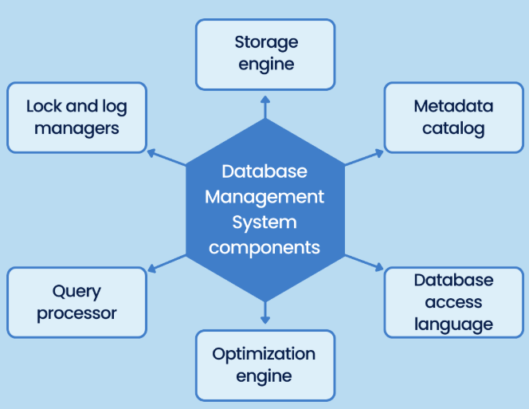
Major Components of DBMS
Query Processor
  Storage Manager
  Lock and log manager
  Buffer Manager
  Metadata Catalog
  Authorization & Security Module

Slide 8
Functions of DBMS
Data Storage, Retrieval & Update
  Transaction Management (ACID properties)
  Concurrency Control
  Backup & Recovery
  Security & Authorization
  Data Integrity Enforcement
  Data Independence

Slide 9
Summary
DBMS architecture consists of three levels: external, conceptual, internal.
  Components work together to ensure: efficient data storage, secure access, high performance, reliability and data integrity.
  DBMS is essential for modern applications requiring structured data management.

Slide 10
THANK YOU

